Slide 1

Adobe Experience Cloud
Lighning Talk
Srinivas Gopinath Parimi
Cloud Solutions Architect
3 August 2022

Slide 2

What is Adobe Experience Cloud (AEC)?
Data Collection
& Query
Governance
& Privacy
Commerce
Data Science
Audiences
AI/ML
Insights
Real-time Customer Profile
Dynamic Assembly
Campaign Planning
Analytics
Activation
Content Activation
Adobe Experience Cloud
Scalable multi-channel personalization
in real-time
Content
Customer
Journeys
Workflows
Orchestration
Social Media
Omni-channel Strategy
Asset Management
Creation
Optimization
Decisioning
Collaboration

Slide 3

What goals can Adobe Experience Cloud help achieve?
Brand awareness
E-mail open rate
Return on ad spend
Customer lifetime value
Customer retention
Customer satisfaction rates
Repeat visitors
Employee satisfaction

Slide 4
CEO’s challenges that Adobe Experience Cloud can address
I need to combine multiple data sources into a single set
I need to unify everything I know about my customers into a customer profile
I need to better automate my marketing
I need to speed up marketing asset creation
I need to be able to dynamically create personalized content on the fly
I need to centralize the management of all my content
I need to be able to deliver content to any channel at the right moment
I need to be able to govern all my data and maintain security and privacy
I need to be able to connect customer experiences across any channel
I need customer profiles to be updated in real-time
I need to connect my commerce experiences (both online and offline) to whole customer journey
I need to manage all the cross-functional work it takes to deliver customer experiences

Slide 5

AEC technology suite
Adobe Experience Cloud
CLOUD
Data Insights & Audiences
Content & Commerce
Customer Journeys
Marketing Workflow
CATEGORIES
Adobe Analytics
Adobe
Customer Journey Analytics
Adobe Real-Time CDP
Adobe Audience Manager
Adobe Experience Manager
Adobe Commerce
Adobe Target
Adobe Campaign
Adobe Journey Optimizer
Adobe Marketo
Engage
Adobe Workfront
APPLICATIONS
Identity
Profile
Segmentation
Ingestion
Query
AI/ML
Privacy & Governance
Destination
SERVICES
Adobe Experience Platform
PLATFORM
Data | Sensei | Content

Slide 6
1 Experience Platform

Slide 7
1 Adobe Experience Platform
Identity
Profile
Segmentation
Ingestion
Query
AI/ML
Privacy & Governance
Destination
Adobe Experience Platform
Data | Sensei | Content
Create actionable, intelligent, real-time customer profiles
Bring in data from multiple sources to create and enhance robust customer profiles that update in real time to ensure right experiences across every channel.
Gain trust with governance, security, and privacy controls
Ensure data is used in line with usage constraints like privacy, contracts, and policies. Keep data safe during collection, storage and disposal.
Enrich data and uncover insights
Streamline data analysis with custom, imported, or out-of-the box data science models. Perform SQL query analysis on data from multiple channels
Innovate with open composable services
Connect with an open platform to start fast and enhance product performance by building new services and custom cloud applications.
Enhance delivery and personalization of real-time experiences at the edge
Look up and activate customer profiles and segments in milliseconds in any system.

Slide 8
2 Data, Insights and Audiences

Slide 9
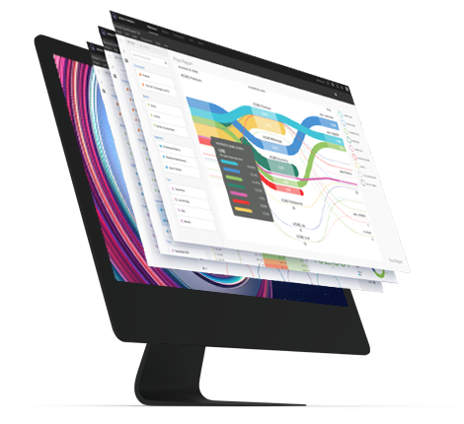
2.1 Adobe Analytics
Collect, organize, analyze, and report everything that the customers do
Insights on-the-go
New Algorithmic Attribution Model
Business users and senior decision-makers can now access insights easily and quickly on their mobile devices and get instant answers to interactive queries.
Users can now evaluate their marketing investments more precisely across paid, earned, and owned media.
Customer Journey Analytics
Empower business intelligence and data science teams to stitch and analyze cross-channel data with a powerful analytics toolkit.

Slide 10
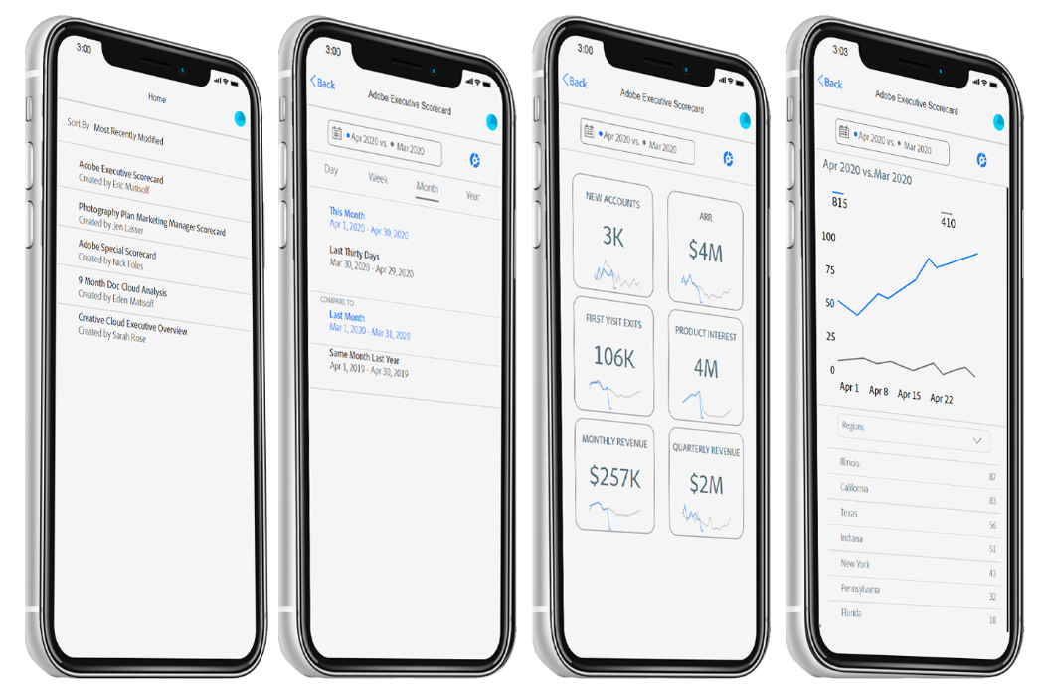
2.1.1 Adobe Analytics Dashboard
Mobile App
An Executive Experience
On demand
decision making
Custom-tailored the app to provide executives with a curated experience that focuses on the data.
Get instant access to metrics that matter with interactive scorecards. Monitor the state of your business through intuitive date-range comparisons.
Analytics you
can trust
Dive deeper into your
key-performance indicators to filter and focus on contributing factors

Slide 11
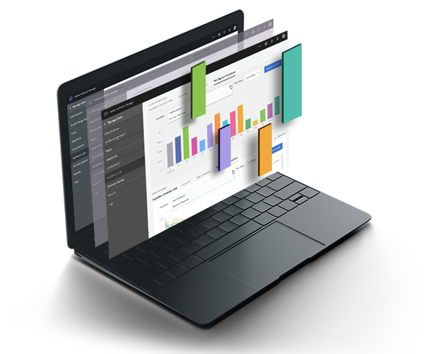
2.2 Audience Manager
Acting on insight requires an audience
Understand Your Audiences
Create New
Segments
Get a complete view of your audience by combining all of your data sources in one place.
Continually discover and organize new, valuable segments for smarter targeting and personalization.
Advertise
Effectively
Make your ad campaigns more productive by targeting specific segments on any platform.

Slide 12
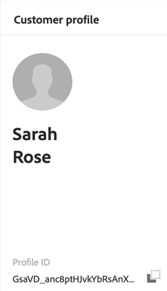
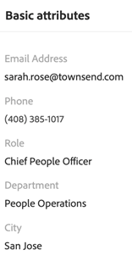
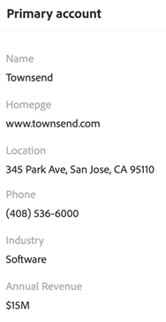
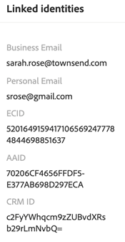
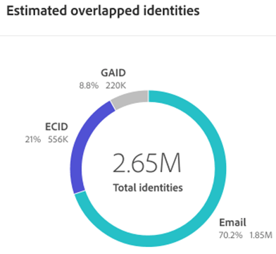
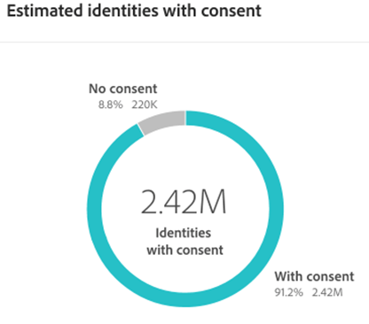
2.3 Real-Time Customer Data Platform
Actionable Real-time Customer Profiles
Customer AI
Predictive Lead & Account Scoring
Build a single view of customers across lines of business and connect to data sources for real-time experience delivery.
Propensity scoring for insights at the individual profile level
Predict and prioritize which customers and
sales opportunities to engage with first
HIPAA Readiness
Segment Match
Privacy compliance for regulated industries
Share audiences between different Adobe Experience Platform instances

Slide 13
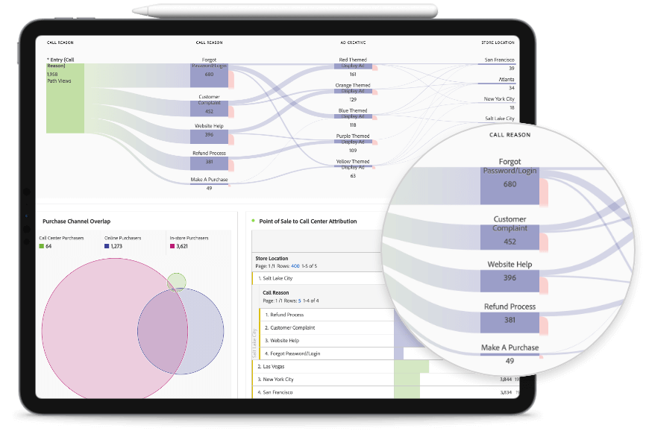
2.4 Customer Journey Analytics
Connect all your customer data together
Interactively explore the whole journey
Connect and standardize data from every online or offline source in Experience Platform for fast, non-destructive querying, analysis, and modeling.
Visualize a customer’s journey across multiple channels sequentially, putting each action in context and enabling cross-channel analysis of things like flow and fallout.
Unlock the power of data science
Data science tools to unlock deeper insights and perform more powerful analysis.

Slide 14
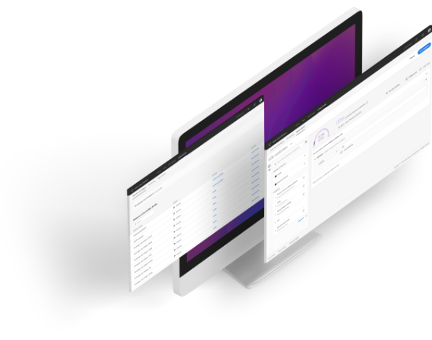
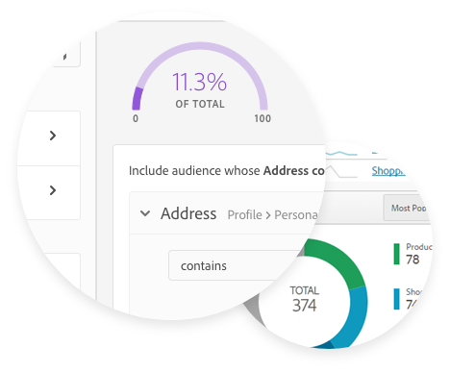
2.4.1 Real-time Customer Profile
Understand your customers
Enhance your personalization
Know your customers’ behaviors and attributes by tying all data together into complete profiles.
Access profiles and use them to deliver the right experiences to the right people at the right moment.
Get all the data. And all the details.
Recency, not just frequency
Capture massive amounts of behavioral, first- and third-party data sources.
Pull in real-time data so your profile is always up to date and your insights are always relevant.

Slide 15
3 Customer Journeys

Slide 16
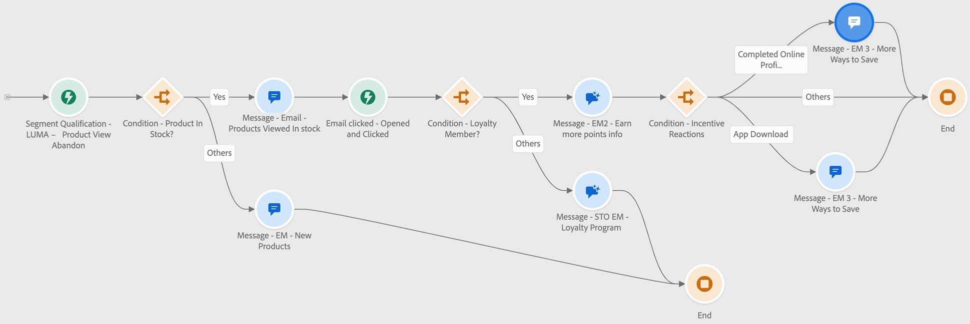
3.1 Journey Optimizer
Modern Omnichannel Orchestration & Execution
A single canvas on which to harmonize and optimize the customer journey for 1:1 customer engagement and marketing outreach across the customer lifecycle.
Intelligent Decisioning & Personalization
Real-time Customer Insights and Engagement
Offer Decisioning
Adobe Target Edge Decisioning capabilities for real-time millisecond personalization
Apply intelligence & gain predictive insights throughout the customer journey to automate decisions and optimize the experience.
Integrated profile fuses live data from all sources across customer touchpoints to optimize personal and contextual experiences
AI-powered ranking algorithms
Intelligent decisioning with optimization and personalization models
Landing Pages and Subscription Management
Opt-ins and opt-outs in marketing outreach
Native channels
Authoring and delivery including SMS and Mobile App in-app messaging

Slide 17
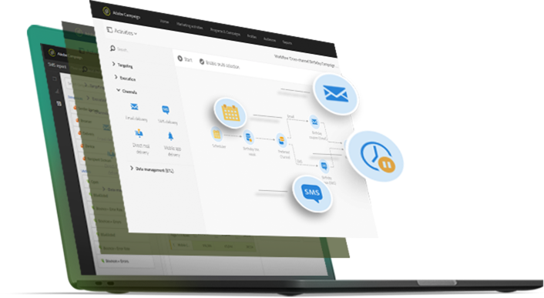
3.2 Adobe Campaign
Cross-channel campaign management tool that helps you improve and personalize campaigns across all your media
Outbound Marketing Campaign Management
Manage your data and monitor the performance of your campaigns from one place.
Enhanced Customer Engagement
Use personalized, contextual and real-time messages to deliver a compelling customer experience.
Automation
Use marketing automation to increase your campaign productivity and reduce your time to market.

Slide 18
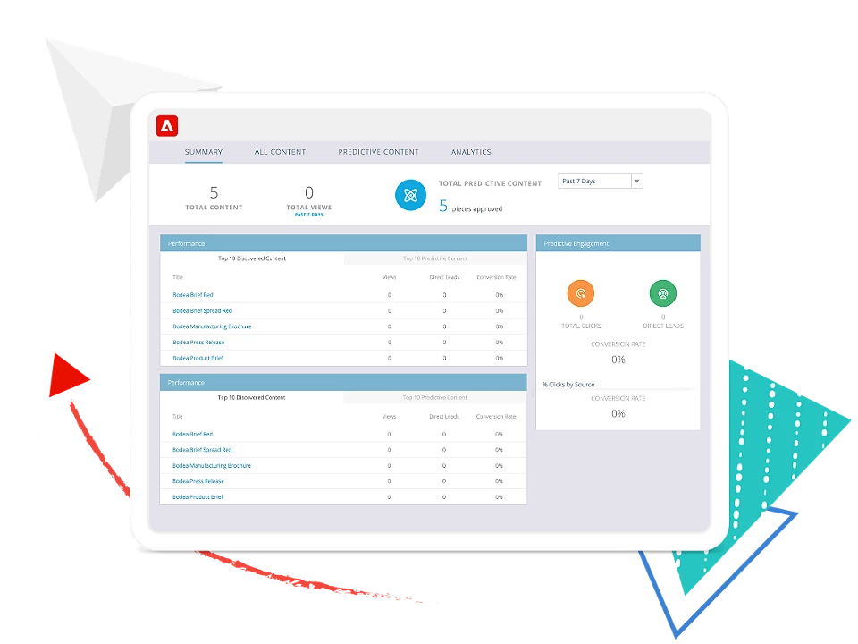
3.3 Marketo Engage
Lead management and account-based marketing
Orchestrate Buyer Journeys
Leverage behavioral data and journey flows to identify, engage, and accelerate the best opportunities for sales.
Personalize at Scale
Use predictive content, A/B testing, and personalization to deliver consistent and relevant experiences.
Multi-channel research
Reach prospects and buyers via all channels - email, display, mobile, social, search, offline.
Prove and Improve Impact
Understand, prove, and optimize your marketing impact with comprehensive measurement and revenue attribution.

Slide 19
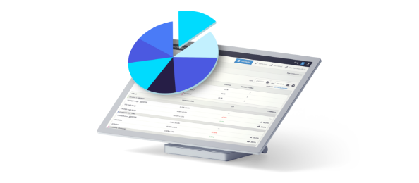
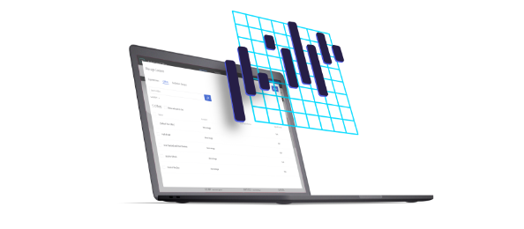
3.4 Adobe Target
Test and optimize every experience, every time.
Omni channel personalization
Unified & progressive profile to give the best experience through every channel.
A/B and Multivariate testing
Easily test the customer experiences through every channel for every journey.
Improve every experience with AI-powered automation & scale
Test and personalize to every visitor, applying artificial intelligence with a single click.

Slide 20
4 Content & Commerce

Slide 21
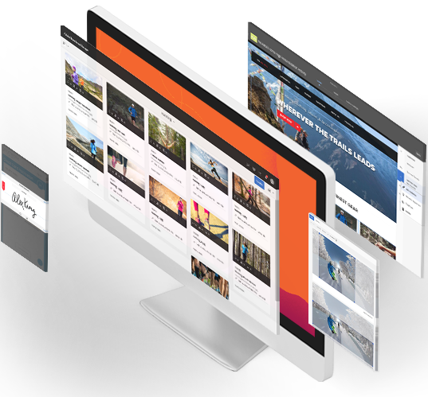
4.1 Adobe Experience Manager
For all your content and digital asset management needs
AEM Cloud Service
Cloud-native content management system featuring optimal performance, SLA based availability and security.
Digital Asset Management
Create, search and adapt content efficiently
Digital Enrollment and Forms
End-to-end solution that connects your forms and communications processes.
Digital Signage
Easily connect online and in-store experiences with interactive signage that’s responsive to customer data and on-side triggers.

Slide 22
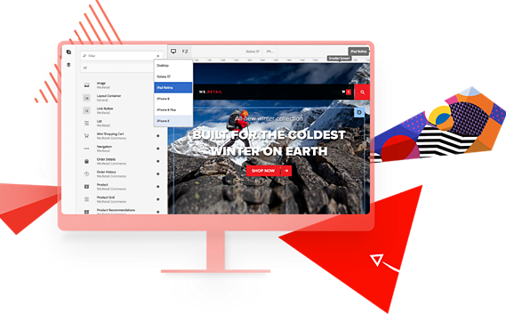
4.1.1 AEM Sites - Content Management
Rapidly create, manage, and deliver personalized experiences across any touch-point throughout the customer journey.
Cross-channel content
Use marketing-friendly templates, developer-facing tools, and success-driven best practices and tools to publish experiences to webpages and modern apps in record time.
Faster Time to Value
Streamline marketing operations and application development to go quickly from design to implementation.
Personalized experiences
Create a unified customer profile spanning the breadth and depth of your data, and then use it to deliver the most relevant experience for each customer in meaningful, memorable ways.

Slide 23
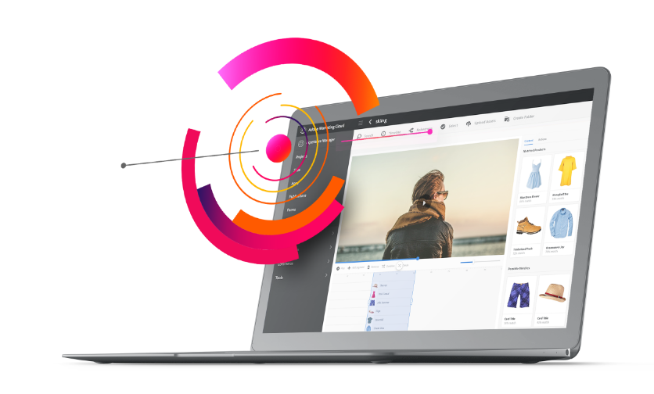
4.1.2 AEM Assets - Digital Asset Management
For all your content and digital asset management needs
Asset Intelligence
Use AI to streamline tagging, cropping and distribution - to do in minutes what used to take hours.
Intelligent automation and delivery
Amplify content velocity by rapidly composing, adapting, and delivering variations across devices and channels
Adobe Workfront Integration
From intake to delivery, you can maximize the value of your content—at scale—by ensuring your digital assets are built, reviewed, approved and automatically tagged to their associated project.

Slide 24
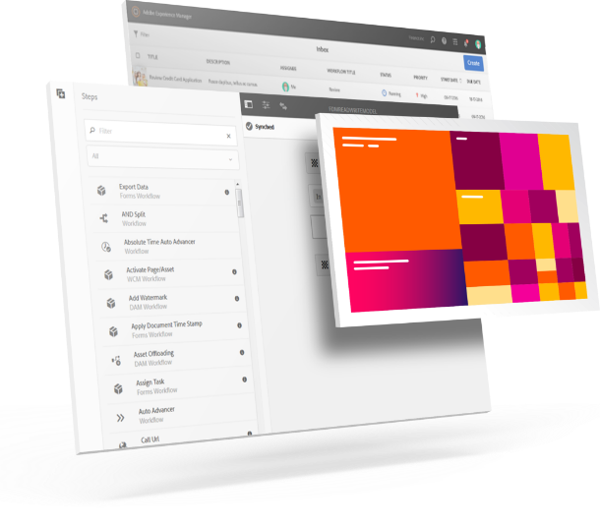
4.1.3 AEM Forms
Forms & Digital enrollment
Responsive forms
Mobile-responsive forms and automated forms conversion to make enrollment easy on any channel.
Scalable authoring
Fragment-based authoring to quickly build multiple forms or communications.
Customer communications
Data integrations to automatically personalize forms and communications
Automate onboarding
Responsive forms combine with smart, secure e-sign tools and automated workflows eliminate manual processes.

Slide 25
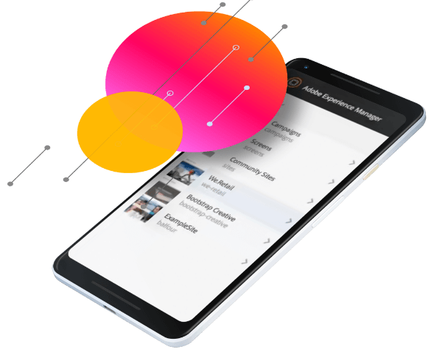
4.1.4 AEM - Cloud Service
For all your content and digital asset management needs
Performance resiliency
Built-in redundancy and proactive monitoring capabilities provide mission-critical service level availability and protect against unpredictable cloud outages.
Modular, scalable, and global
Scale on demand to always maintain high performance globally
Always current
New experience management capabilities are seamlessly validated and made accessible to your teams instantly.
Secure by default
Enterprise-grade security with industry recognized standards

Slide 26
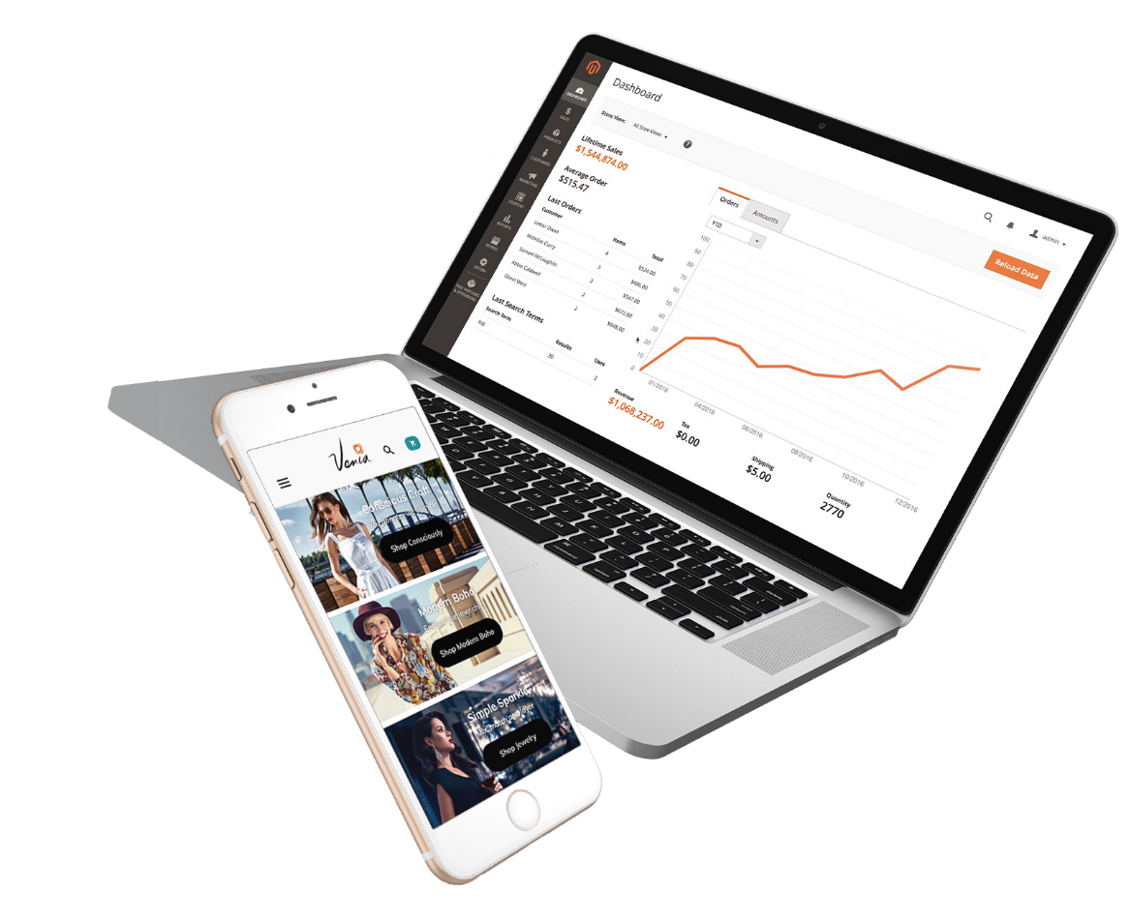
4.2 Adobe Commerce
Sell anywhere with omni-channel experiences
Search & merchandising
Boost sales with AI-powered B2B & B2C search and dynamic category merchandising (H2 2022)
Commerce AEP connector
Leverage Commerce data for richer customer profiles and personalization at scale (H2 2022)
Advanced store fulfillment
Offer buy online/pick up in store or curbside fulfillment powered by Walmart Commerce Technologies
Commerce intelligence
Measure and optimize campaigns with commerce intelligence that enables segmentation and targeting to help identify the most profitable customers.

Slide 27
5 Workfront

Slide 28
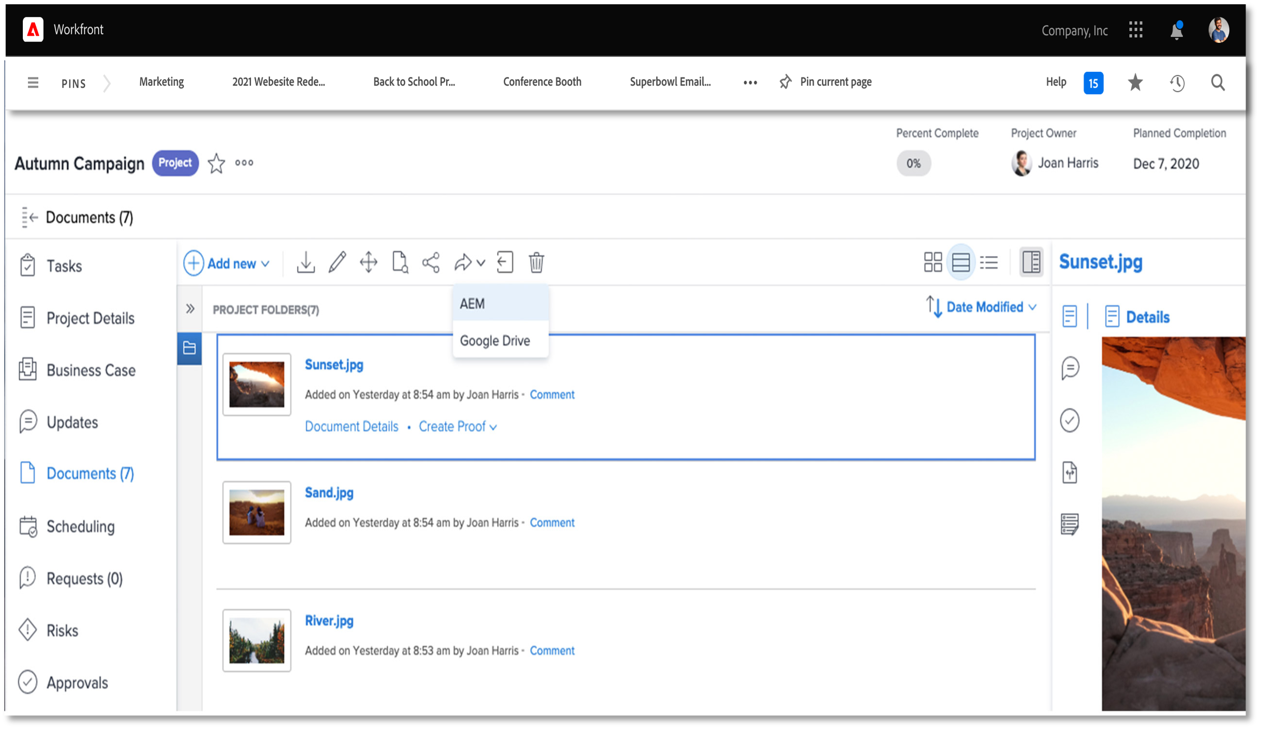
6 Adobe Workfront
Speed time to market and empower your teams by efficiently managing the end-to-end lifecycle of work.
Align strategy across the organization
Connect business strategy to work delivery and ensure that the right work is prioritized.
Plan and prioritize work
Allocate budget to priorities, optimize resource pools, iteratively balance portfolio, and efficiently plan work.
Streamline work execution
Centralize work in a single place and standardize and automate work processes—from intake and resourcing all the way to completion.
Measure and optimize work
Collaborate, review and approve
Deliver against strategy, measure productivity, ensure quality and compliance, and optimize future initiatives with rich historical data.
Simplify reviews and audit approvals. Collaborate across divisions, keep teams productive, and execute with agility.

Slide 29
5 Adobe Workfront
AEM Assets integration
Manage assets and optimize the end-to-end content lifecycle through the integration with AEM Assets
Creative Cloud integration
Keep creative teams productive with Workfront plugins for Adobe Creative Cloud apps including Photoshop, XD, Illustrator, and InDesign.
Agile for Marketing teams
Work in quick, iterative sprints and easily pivot when circumstances change with Agile boards designed specifically for marketing teams.
Marketing financial management
Partnership with Anaplan to unify marketing work with financials and to enable productive spend management.

Slide 30
Thank you

